Slide 1
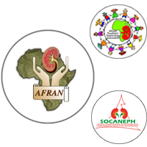
Dialyse au cours de l’IRA
French CNE course organized with AFRAN/SFNDT
FMC Francophone en Néphrologie organisée par AFRAN/SFNDT
Tarik SQALLI – Fès – Maroc
AFRAN 2017
Yaoundé, 14 MARS 2017

Slide 2
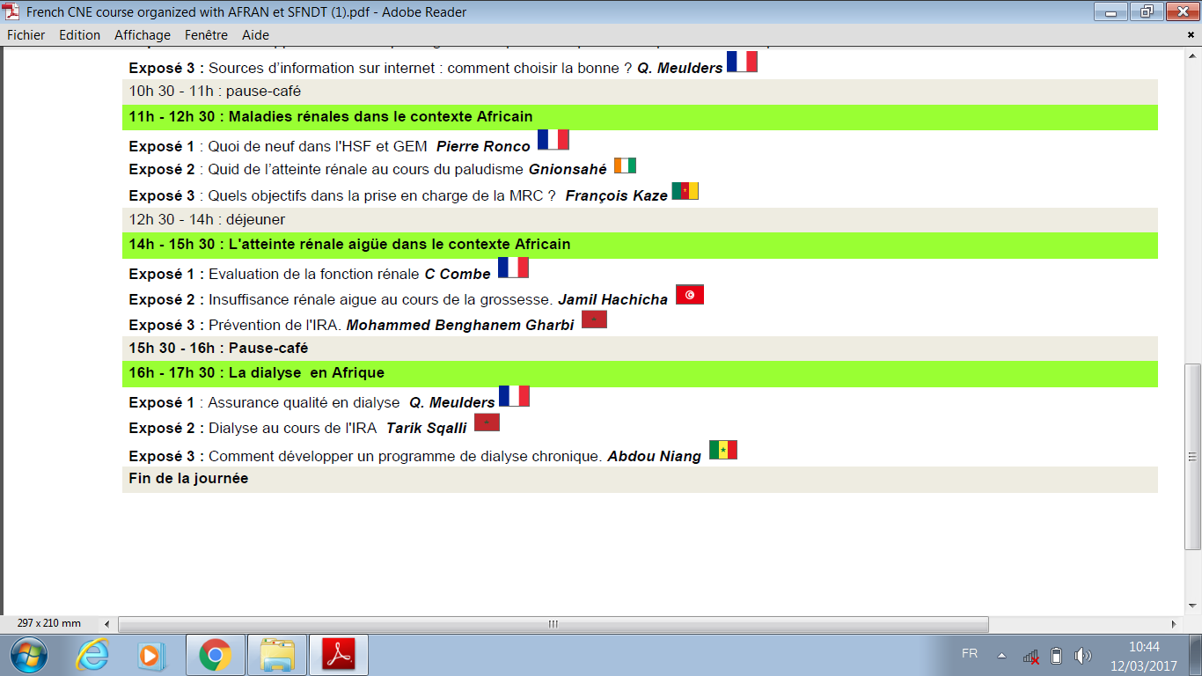
Programme

Slide 3
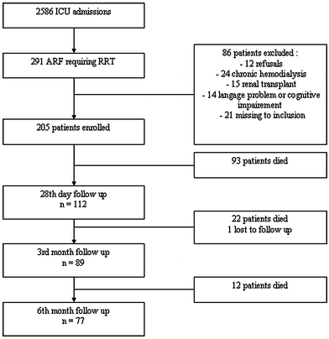
L’Insuffisance Rénale Aiguë tue!!
Mortalité cumulée
J28: 45%
M3: 56%
M6: 62%
Qualité de vie altérée chez les survivants
B. Delannoy; Intensive Care Med (2009) 35: 1907-15
Notes:
Six month outcome in acute kidney injury requiring renal replacement therapy in the ICU: a multicentre prospective study.
Intensive Care Med (2009) 35: 1907-15
B Delannoy et al

Slide 4
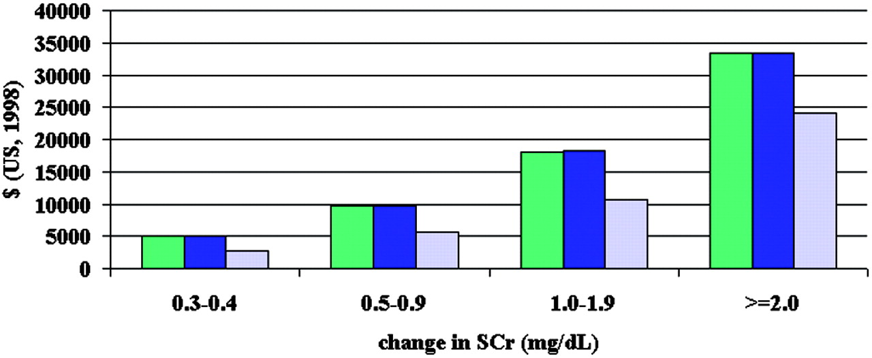
L’Insuffisance Rénale Aiguë est coûteuse!
unadjusted
age and gender adjusted
multivariable adjusted
Chertow GM et al. JASN 2005;16:3365-3370
Notes:
Etude americaine momocentrique “AKI mortality, length of stay and costs in hospitalized patients, rétrospective sur 8 mois de sept 97 à avril 98, 19982 admissions.
Mean hospital costs associated with changes in SCr. Green bars are unadjusted, blue bars are age and gender adjusted, and gray bars are multivariable adjusted. Multivariable analyses adjusted for age, gender, DRG weight, and ICD-9-CM codes for cardiovascular, respiratory, malignant, and infectious diseases; n = 1564, 885, 246, and 105 for change in SCr 0.3 to 0.4, 0.5 to 0.9, 1.0 to 1.9, and ≥2.0 mg/dl.
Pour chaque augmentation de 5mg/l, surcout moyen de 7500 dollars.

Slide 5
Auteurs | N cas | Mono / multicentr | Lieu | Année | Population | Définition de l’IRA | Incidence IRA (%) | Lieu de décès | Mortalité (%)
Thakar et coll.⁵⁹ | 325395 | Multi | USA |  | Variée | RIFLE | 22 | USI | 10,9
Ostermannet Chang⁶⁰ | 41972 | Multi | 22 USI UK/ Germ | 1989-1999 | variée | RIFLE | 35,8 | USI Hôpital | 10,2 12,9
Clec’h et al⁶¹ | 8639 | Multi | 13 USI en France | Janv 1997-juin 1999 | Variée (>16 ans) | RIFLE | 32,9 | USI | 27,6
Gammelager et coll.⁶² | 30762 | Multi | USI nord Danemark | 2005-2010 | Variée | RIFLE | 15,6 | 30 jours | 40
Joannidis et coll.⁶³ | 16784 | Multi | 303 USI, USA | 2009 | Variée | RIFLE | 35,5 | USI Hôpital | 7,1 36,4
Mandelbaum et coll.⁶⁴ | 14524 | Mono | 3 USI _ USA | 2001-2007 | Variée | AKIN | 57 | USI Hôpital | 7,1 9,1
Hoste et coll.⁶⁵ | 5383 | Mono | 7 USI _USA | 2000-2001 | Variée | RIFLE | 67,2 | Hôpital | 13,3
Cruz et coll.⁶⁶ | 2164 | Multi | 19 USI _ Italie | Avril2003-juin 2003 | Variée | RIFLE | 10,8 | USI | 36,3
Samimagham et coll.⁶⁷ | 1026 | Mono | USI _Iran | 2005-2006 | Variée | RIFLE | 21,7 | USI | 49
Fonseca Ruiz et coll.⁶⁸ | 794 | Mono | USA | 2003-2004 | Variée | AKIN | 39,8 | USI Hôpital | 25,4 32,1
Piccinni et coll.⁶⁹ | 576 | Multi | 10 USI _ Italie | Sept 2009-avril 2010 | Variée | RIFLE | 42,7 | USI | 29
Medve et Gondos ⁷⁰ | 459 | Mono | Hongrie | Octob- Nov 2009 | Variée | AKIN | 24,4 | USI Hôpital | 39,3 49,1
Samimagham et coll.⁶⁷ | 235 | Mono | USI _Iran | 2005-2006 | Variée | AKIN | 31,1 | USI | 72,6
Yue et coll.⁷¹ | 191 | Mono | Chine | 2008-2009 | Variée | AKIN | 35,5 | USI | 48
……………..
Etudes monocentriques
USI
Etudes africaines?

Slide 6
«L’IRA vue par les Néphrologues »
Enquête nationale - Maroc 2013
Incidence
Descriptive
Epidémiologie
Etiopathogénie
Pronostic
Analytique
Facteurs de risque
El Khayat S et al.

Slide 7
«L’IRA vue par les Néphrologues »
Enquête nationale - Maroc 2013
Appel à participer: Néphrologues
Etude prospective: 1er Sept 2012 - 28 Févr 2013
Critères d’inclusion: cas incidents d’IRA (KDIGO 2012; RBPM 2009)
Support de recueil des données
El Khayat S et al.
Notes:
Cette étude a inclut tous les patients en IRA recrutés par des néphrologues durant la période de l’étude et répondants aux critères diagnostics établies par les recommandations 2012 du KDIGO (chapitre 3d).
Il s’agissait d’IRA organiques, fonctionnelles ou obstructives, d’acutisation d’une insuffisance rénale chronique (IRC), chez des patients d’âge variable, ayant recouru ou pas à la dialyse. Aucun critère d’exclusion n’a été retenu. Chaque patient a été suivi par son néphrologue traitant pendant une durée de 3 mois pour établir l’évolution.
Les néphrologues ont été contactés par email, ils ont reçu et rempli la fiche d’exploitation à laquelle était attachée une annexe citant les recommandations pour la réalisation de l’étude.

Slide 8
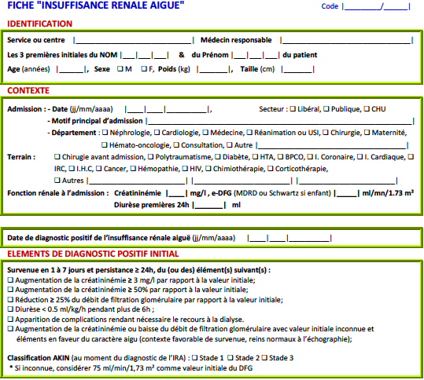

Slide 9
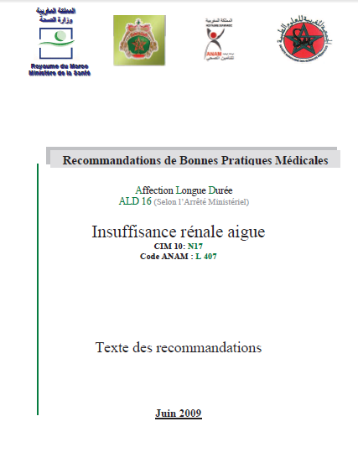
Référentiel
www.nephro-maroc.org

Slide 10
Diagnostic positif de l’IRA
Survenue en 1 à 7 jours et persistance ≥ 24h, du (ou des) élément(s) suivant(s) :
  créatininémie ≥ 3 mg/l /valeur initiale
  créatininémie ≥ 50% /valeur initiale;
  ≥ 25% du DFG /valeur initiale;
  Diurèse < 0.5 ml/kg/h pendant plus de 6h ;
  Apparition de complications avec dialyse nécessaire.
  créatininémie ou DFG avec valeur initiale inconnue et éléments en faveur du caractère aigu (contexte favorable de survenue, reins normaux à l’échographie);

Slide 11
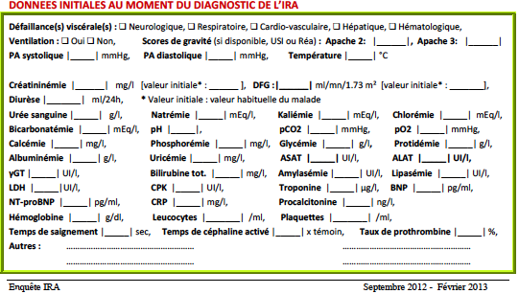
Recueil de données

Slide 12
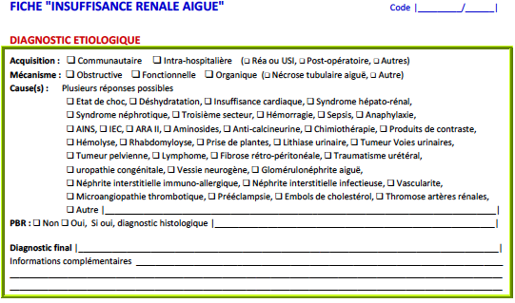
Recueil de données

Slide 13
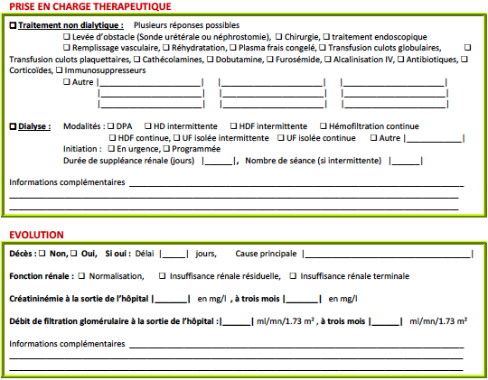
Recueil de données

Slide 14
Recueil de données

Slide 15
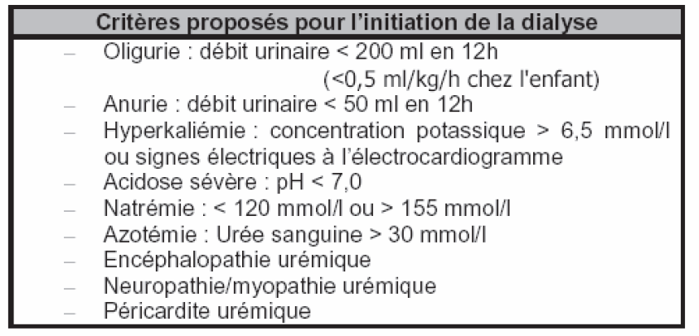
Quand commencer la dialyse?
Mais aussi comme un mode de support thérapeutique multi-organes (Multiorgan support therapy, MOST)
RBPM, ALD 17
Notes:
Le but est de comparer les pratiques par rapport au référentiel national

Slide 16
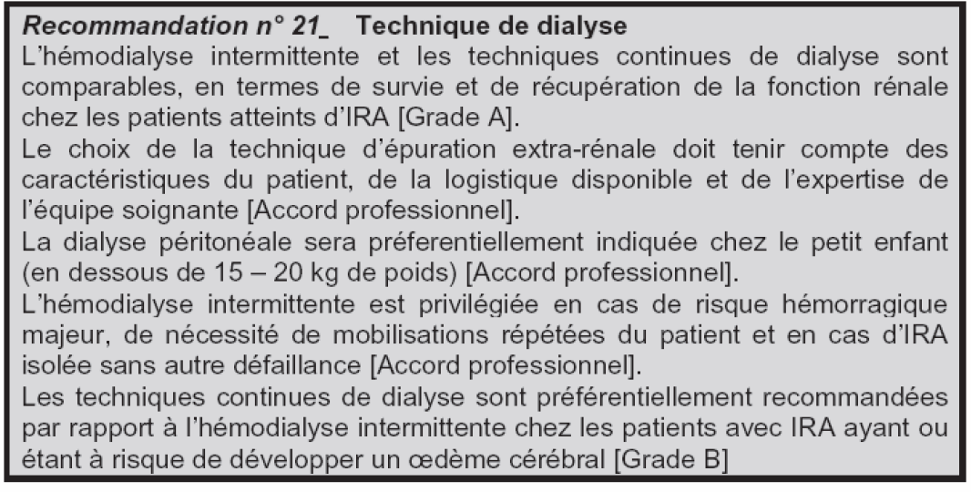
Quelle technique pour quel patient?
RBPM, ALD 17

Slide 17
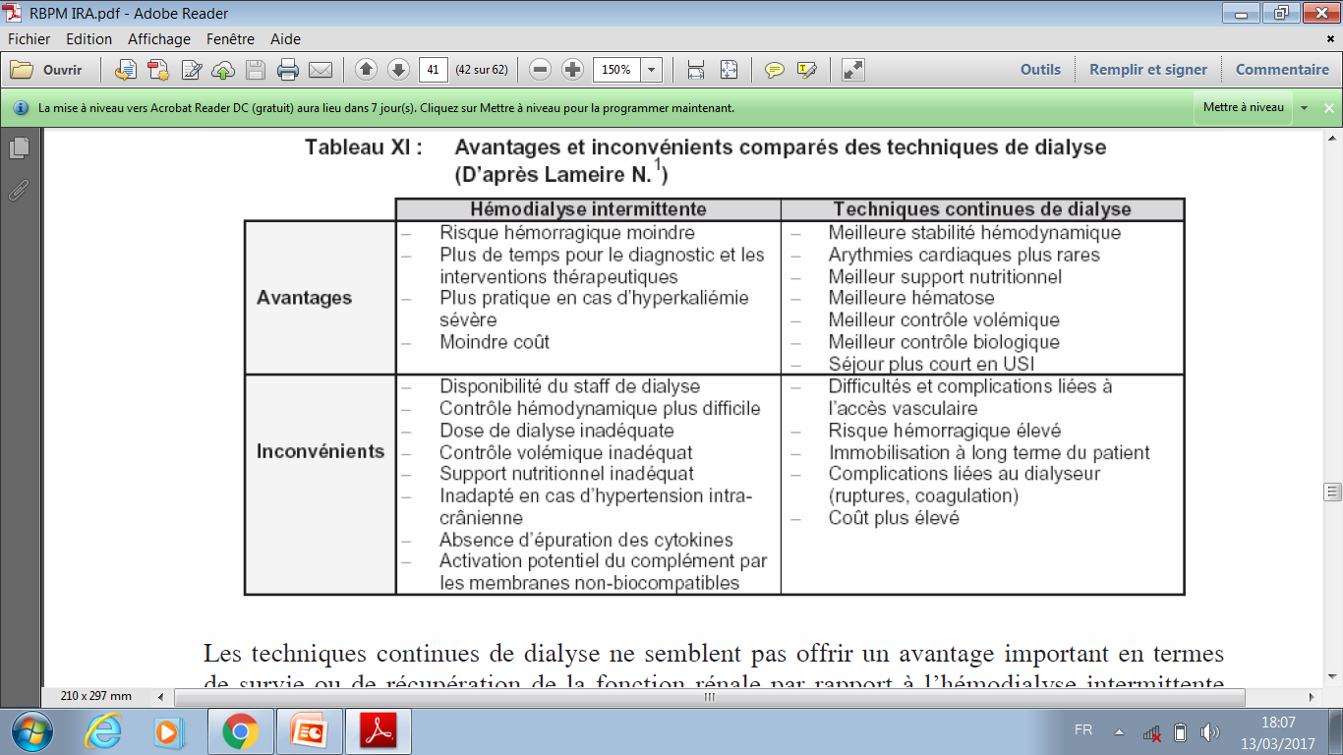
Comparaison des techniques de dialyse
RBPM, ALD 17

Slide 18
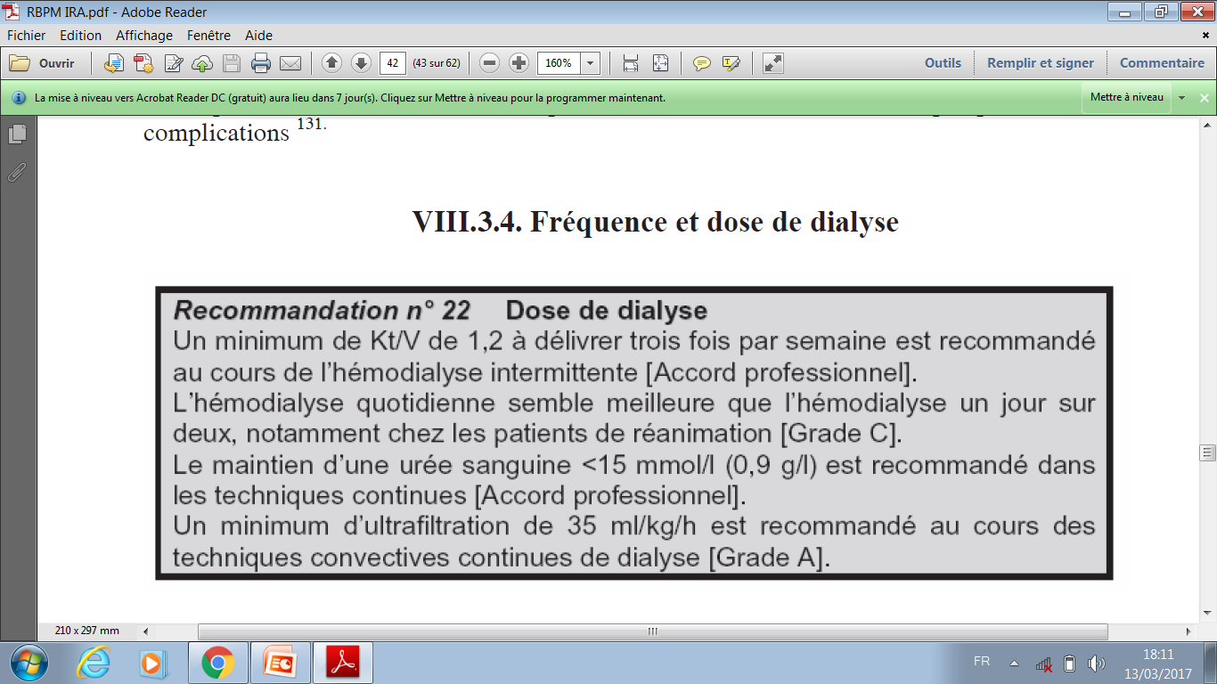
Fréquence et dose de dialyse
RBPM, ALD 17

Slide 19
«L’IRA vue par les Néphrologues »
Enquête nationale - Maroc 2013
Centres
privés
Centres
publics
105
113
14
(13%)
16
(14%)
541 cas
30 unités

Slide 20
Résultats: présentation clinique
Médiane d’âge
57 ans
Sexe
Sex-ratio H/F: 1.14

Slide 21
IRA communautaire # hospitalière

Slide 22
IRA selon la classification AKIN

Slide 23
Causes IRA Maroc: Top 10

Slide 24
IRA Afrique : 3 premières causes par pays
Maroc
Seifu L. AFRAN Congress, Agadir, Morocco, 2004 ; Lengani A et al. Nephrol Ther. 2010 Feb;6(1):28-34
Notes:
The contribution of different causes is not as uniform as one might think.
For example, ingestion of plants is the leading cause of ARF in Malawi and D.R. of Congo, Malaria In Benin and Ethiopia, Sepsis in Burkina Faso and deshydratation by acute gastroenteritis in Guinea and Togo. In Ethiopia, obstetric causes as unsafe abortion, still represent an important etiology of AKI

Slide 25
Traitement dialytique
Hémodialyse: 96%
4 ± 7,42 séances
6,32 ± 12,52 jours

Slide 26
Facteurs de risque de dialyse
Etude univariée / multivariée
s

Slide 27
Evolution: Sortie de l’hôpital
Notes:
At discharge, death ratio was 24%. As outcome of renal function, ESRD was present in 15% of cases and the complete recovery of normal renal function in 17%.
The main cause of death was septic shock, present in 40% of cases, followed by hemorrhagic and cardiogenic shocks. ≥≤

Slide 28
Evolution: Causes de décès
Délai: 8,1 j± 12,9 j

Slide 29
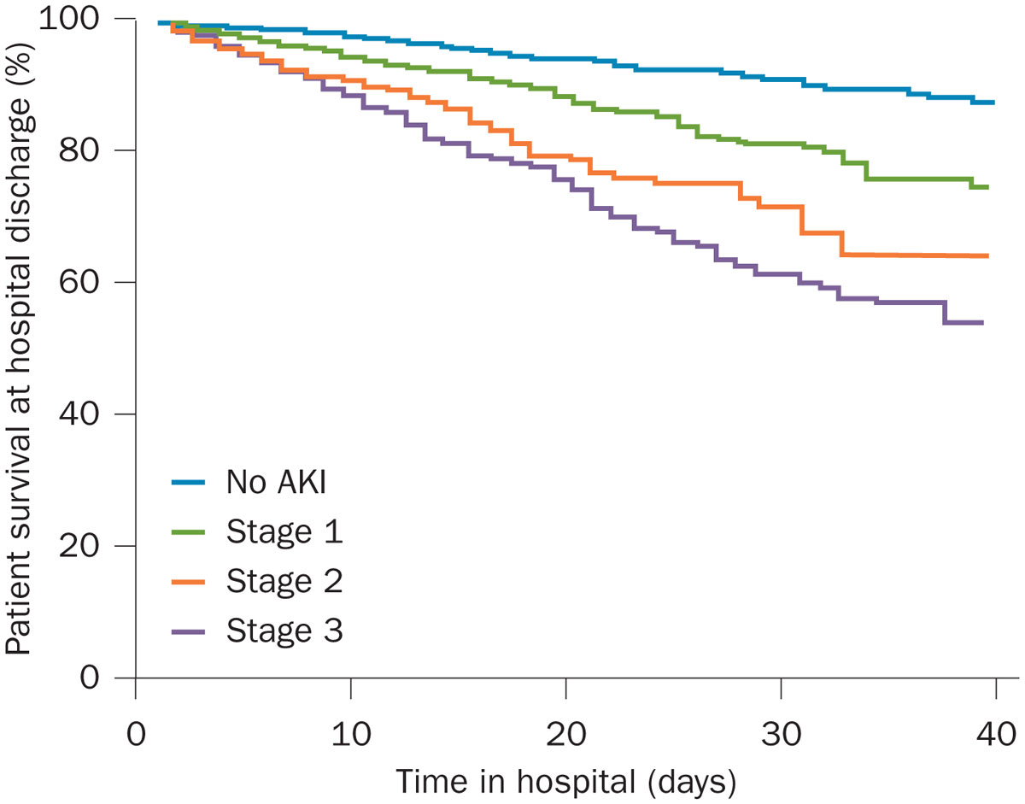
Survie hospitalière et stade d’IRA
Wang H. E. et al. Nephrol Dial Transplant. 2013 Jun;28(6):1447-54 .
Notes:
IRA hosp et commun chez les patients chinois hospitalisés: revue: étude rétrospective sur 10 ans, monocentrique, hopital universitaire de pekin

Slide 30
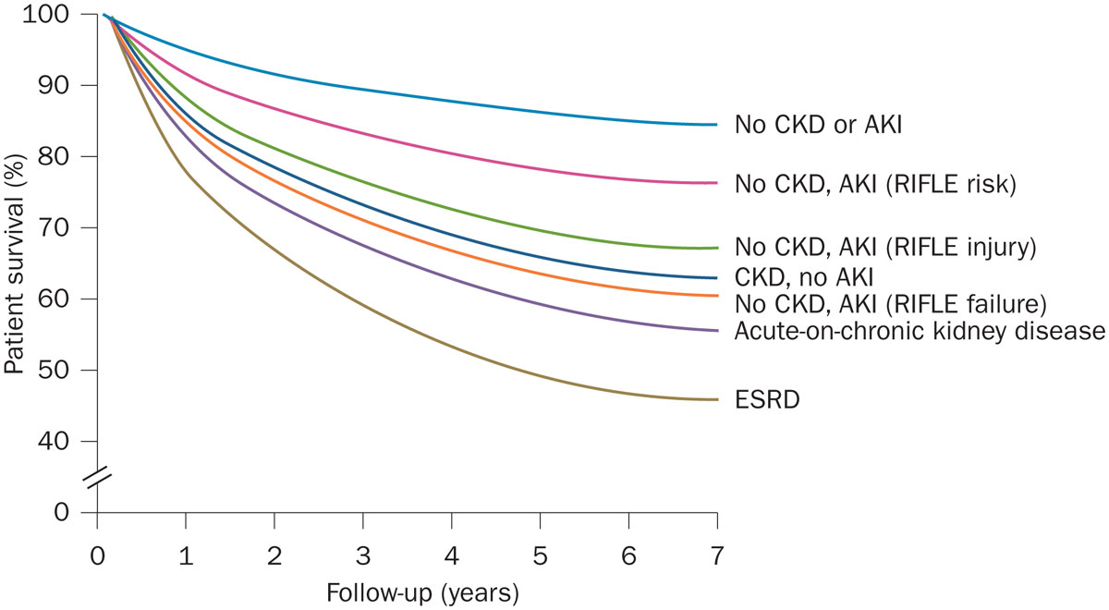
Survie à long terme et stade d’IRA
Wu, V. C. et al. Kidney Int. 80, 1222–1230 (2011)
Notes:
Cox proportional hazard model for long-term survival of patients alive at hospital discharge, stratified by severity of AKI for patients without CKD (no AKI and RIFLE risk, injury, and failure groups) and by occurrence of AKI for patients with CKD (no AKI and acute-on-chronic kidney disease groups). Abbreviations: AKI, acute kidney injury; CKD, chronic kidney disease; ESRD, end-stage renal disease; RIFLE, risk, injury, failure, loss, end-stage renal disease. Reproduced with permission from Nature Publishing Group © Wu, V. C. et al. Kidney Int. 80, 1222–1230 (2011).

Slide 31
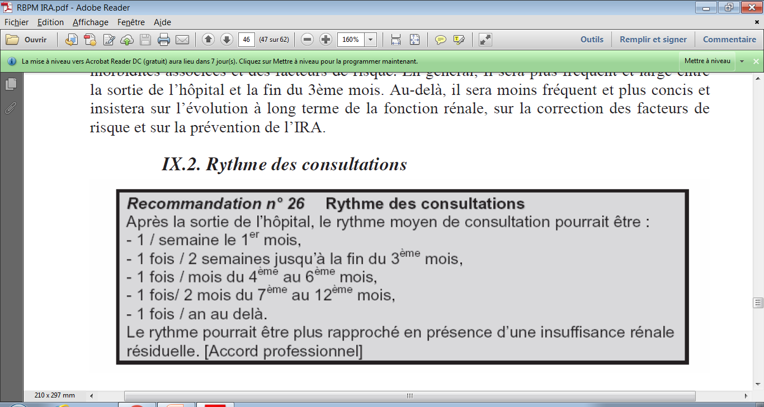
Suivi post-IRA
RBPM, ALD 17

Slide 32

J’ai toujours beaucoup de questions

Slide 33
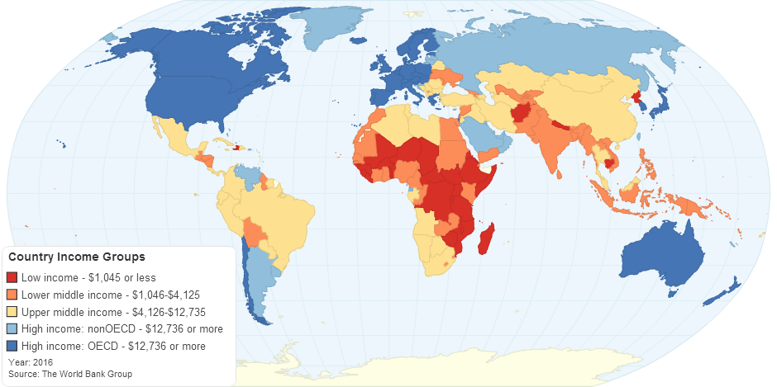
Pays développés Vs Pays à faible revenu
Classification de la banque mondiale

Slide 34
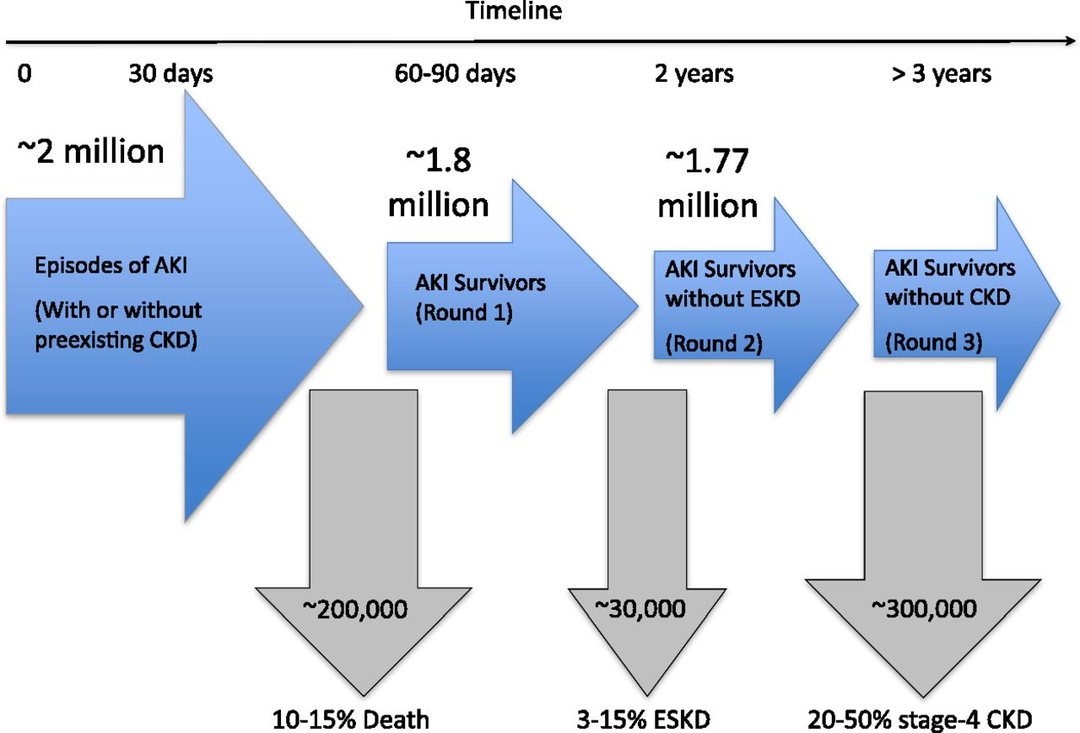
Poids de l’IRA & devenir des survivants
Pays développés
Goldstein S L et al. CJASN 2013;8:476-483
Notes:
Estimation de l’IRA dans les pays développés et devenir des survivants
Estimates of AKI burden in developed countries and outcomes of survivors. Assumptions are based on an estimated population of about 1 billion in developed countries, which represent the United States, Canada, Europe, and Australia/New Zealand, and an AKI incidence of 2147 cases per million people. ESKD, end-stage kidney disease.

Slide 35

Et en Afrique?
Outcomes of acute kidney injury in children and adults in sub-Saharan Africa: a systematic review
Prof Wasiu A Olowu, MBBS, Prof Abdou Niang, MD, Charlotte Osafo, MBChB, Prof Gloria Ashuntantang, MD, Prof Fatiu A Arogundade, MBBS, Prof John Porter, MD, Prof Saraladevi Naicker, MBChB, Dr Valerie A Luyckx, MBBCh
The Lancet Global Health
Volume 4, Issue 4, Pages e242-e250 (April 2016)
DOI: 10.1016/S2214-109X(15)00322-8
Copyright © 2016 Olowu et al. Open Access article distributed under the terms of CC BY

Slide 36
Outcomes of acute kidney injury in children and adults in sub-Saharan Africa: a systematic review
Figure 1
The Lancet Global Health 2016 4, e242-e250DOI: (10.1016/S2214-109X(15)00322-8)
Notes:
Study selection
*WHO Global Health Library includes African Index Medicus.

Slide 37
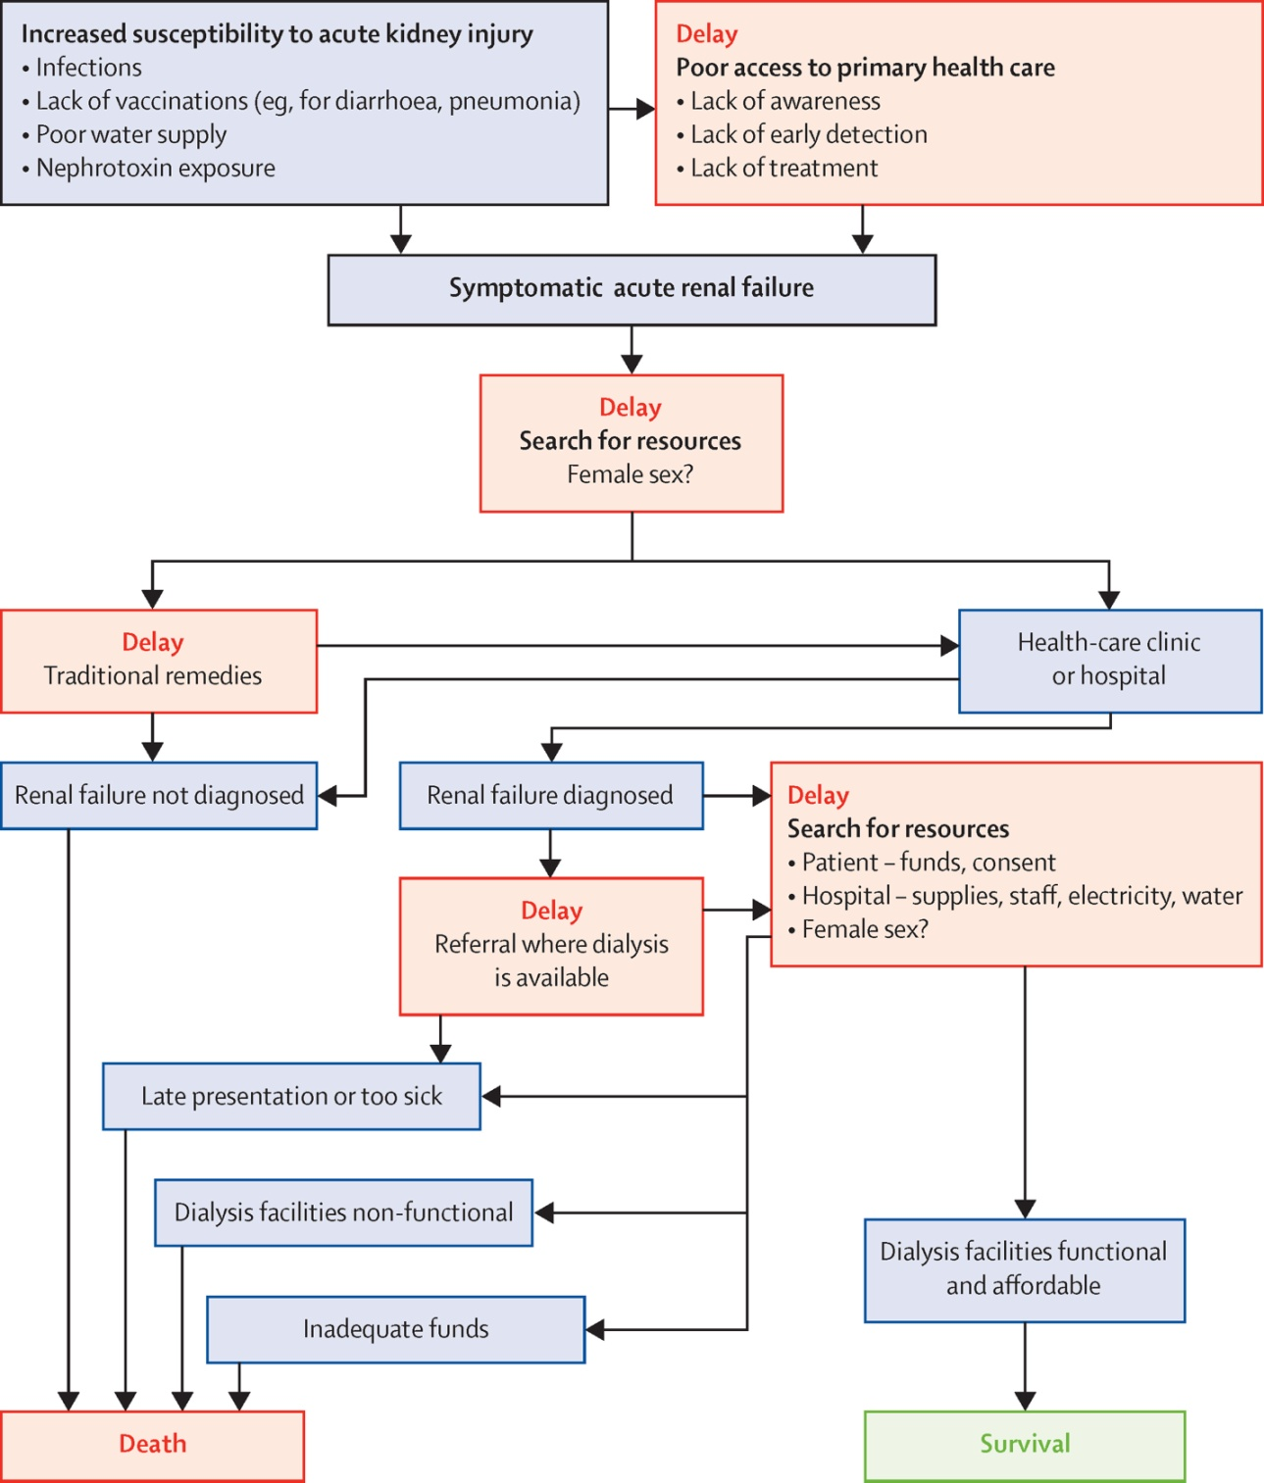
Figure 2
Copyright © 2016 Olowu et al. Open Access article distributed under the terms of CC BY
The Lancet Global Health 2016 4, e242-e250DOI: (10.1016/S2214-109X(15)00322-8)
Notes:
Barriers to care in acute kidney injury
Outcomes shown for each pathway (survival or death) are the most likely outcomes, but are not inevitable (table 4).

Slide 38
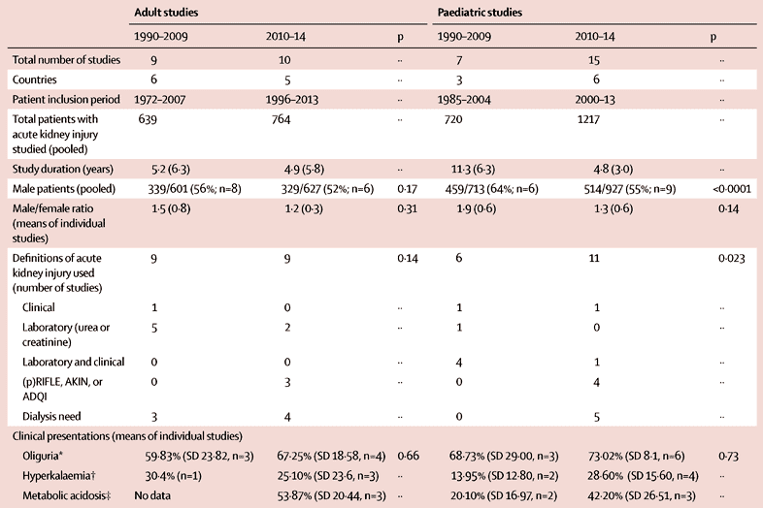
Acute kidney injury study populations

Slide 39
Causes of acute kidney injury in children and adults
 | Children* (n=1643) | Adults † (n=993)
Infection | 380 (23%) | 274 (28%)
Glomerular disease | 350 (21%) | 76 (8%)
Nephrotoxin | 270 (16%) | 182 (18%)
Intravascular volume depletion or hypoperfusion | 174 (11%) | 50 (5%)
Obstructive uropathy | 146 (9%) | 46 (5%)
Vascular disease or haemolysis | 116 (7%) | 11 (1%)
Medical, other | 0 | 36 (4%)
Malignancy | 40 (2%) | 19 (2%)
Birth asphyxia | 27 (2%) | 0
Obstetric or gynaecological | 0 | 157 (16%)
Surgical | 0 | 54 (5%)
Unspecified | 140 (9%) | 88 (9%)
*17 paediatric studies. †14 adult studies.
Notes:
Vascular = 99% SHU

Slide 40
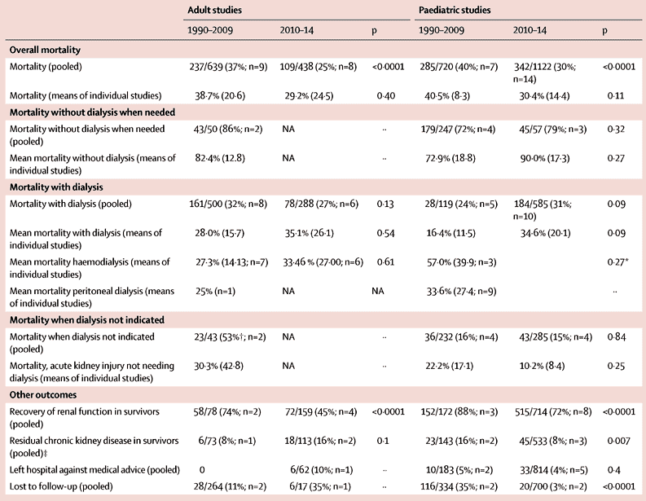
Figure 2
The Lancet Global Health 2016 4, e242-e250DOI: (10.1016/S2214-109X(15)00322-8)
Outcomes in children and adults with acute kidney injury
Notes:
Barriers to care in acute kidney injury
Outcomes shown for each pathway (survival or death) are the most likely outcomes, but are not inevitable (table 4).

Slide 41
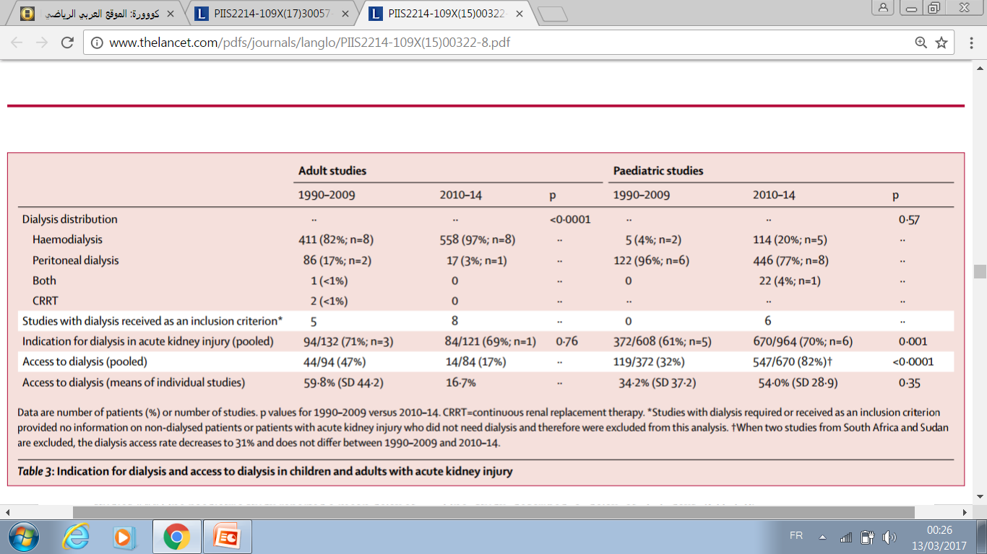
Indication for dialysis and access to dialysis in adults and children with AKI
The Lancet Global Health 2016
Notes:
FINDINGS:
We identified 3881 records, of which 41 met inclusion criteria, including 1403 adult patients and 1937 paediatric patients. Acute kidney injury in sub-Saharan Africa is severe, with 1042 (66%) of 1572 children and 178 (70%) 253 of adults needing dialysis in studies reporting dialysis need. Only 666 (64%) of 1042 children (across 11 studies) and 58 (33%) of 178 adults (across four studies) received dialysis when needed. Overall mortality was 34% in children and 32% in adults, but rose to 73% in children and 86% in adults when dialysis was needed but not received. Major barriers to access to care were out-of-pocket costs, erratic hospital resources, late presentation, and female sex.
INTERPRETATION:
Patients in these studies are those with resources to access care. In view of overall study quality, data interpretation should be cautious, but high mortality and poor access to dialysis are concerning. The global scarcity of resources among patients and health centres highlights the need for a health-system-wide approach to prevention and management of acute kidney injury in sub-Saharan Africa.

Slide 42
Conclusions: Indication for dialysis and access to dialysis in adults and children with AKI
AKI in sub-Saharan Africa is severe:
  66% of children and 70% of adults needing dialysis
Only 64% of children and 33% of 178 adults received dialysis when needed.
Overall mortality was 34% in children and 32% in adults.
Major barriers to access to care were:
  out-of-pocket costs,
  erratic hospital resources,
  late presentation,
  and female sex.

Slide 43
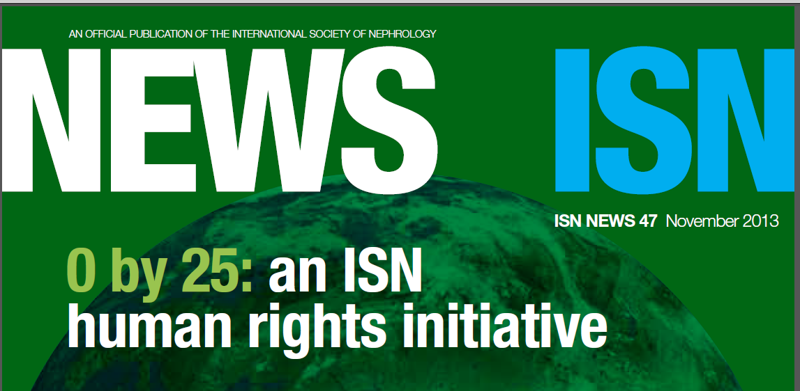
« 0 by 25 »
Nobody in emerging countries should die of acute kidney failure (AKF) by 2025.

Slide 44
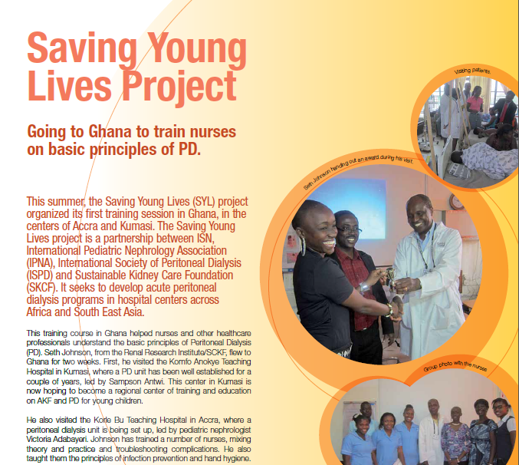
Développer la DP dans l’IRA de l’enfant
Notes:
Accra et Kumasi

Slide 45

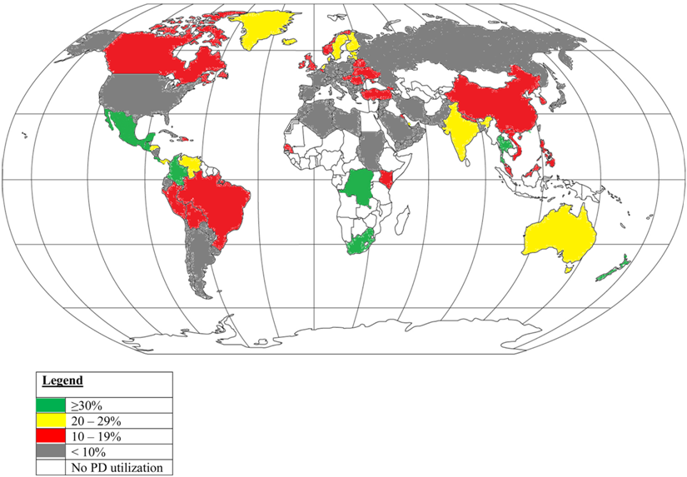
From: A review of acute and chronic peritoneal dialysis in developing countries
Clin Kidney J. 2015;8(3):310-317. doi:10.1093/ckj/sfv029
© The Author 2015. Published by Oxford University Press on behalf of ERA-EDTA.This is an Open Access article distributed under the terms of the Creative Commons Attribution Non-Commercial License (http://creativecommons.org/licenses/by-nc/4.0/), which permits non-commercial re-use, distribution, and reproduction in any medium, provided the original work is properly cited. For commercial re-use, please contact journals.permissions@oup.com
Notes:
République démocratique du Congo et Afrique du Sud; Kenya;
Abstract
Various modalities of renal replacement therapy (RRT) are available for the management of acute kidney injury (AKI) and end-stage renal disease (ESRD).
While developed countries mainly use hemodialysis as a form of RRT, peritoneal dialysis (PD) has been increasingly utilized in developing countries. Chronic PD offers various benefits including lower cost, home-based therapy, single access, less requirement of highly trained personnel and major infrastructure, higher number of patients under a single nephrologist with probably improved quality of life and freedom of activities. PD has been found to be lifesaving in the management of AKI in patients in developing countries where facilities for other forms of RRT are not readily available.
The International Society of Peritoneal Dialysis has published guidelines regarding the use of PD in AKI, which has helped in ensuring uniformity.
PD has also been successfully used in certain special situations of AKI due to snake bite, malaria, febrile illness, following cardiac surgery and in poisoning.
Hemodialysis is the most common form of RRT used in ESRD worldwide, but some countries have begun to adopt a ‘PD first’ policy to reduce healthcare costs of RRT and ensure that it reaches the underserved population.
45

Slide 46
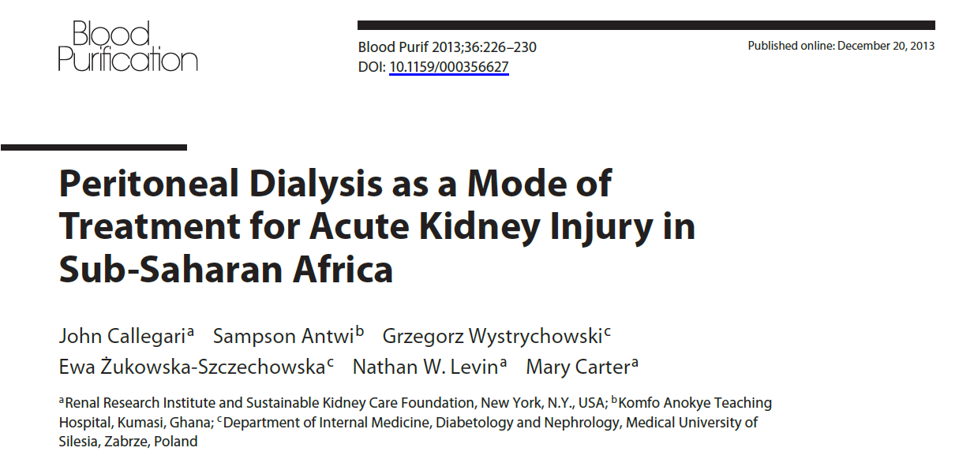
DP dans le traitement de l’IRA en Afrique

Slide 47
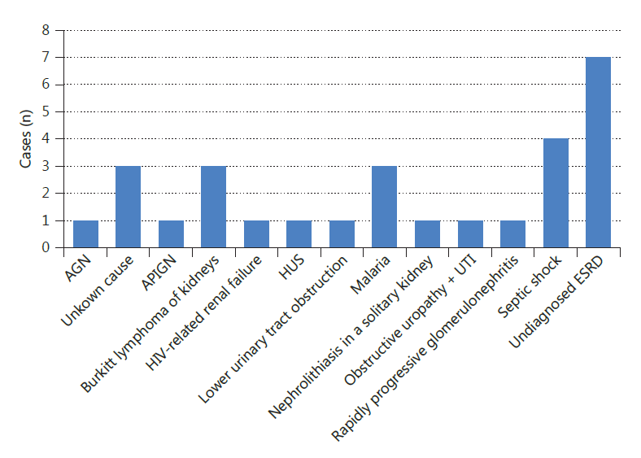
PD in Sub-Saharan Africa
Kumasi, Ghana
PD for 28 children
1 month to 13 years
17 females and 11 males.
Causes of AKI. ESRD = End-stage renal disease; AGN = acute glomerulonephritis; APIGN = acute postinfectious glomerulonephritis; HUS = hemolytic uremic syndrome; UTI = urinary tract infection.

Slide 48
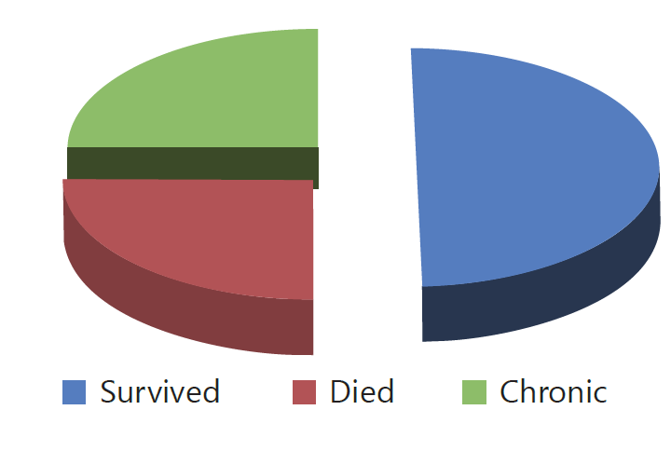
PD in Sub-Saharan Africa
Outcome of patients of the Komfo Anokye Teaching Hospital in 2012.
Callegari J et al. Blood Purif 2013.

Slide 49
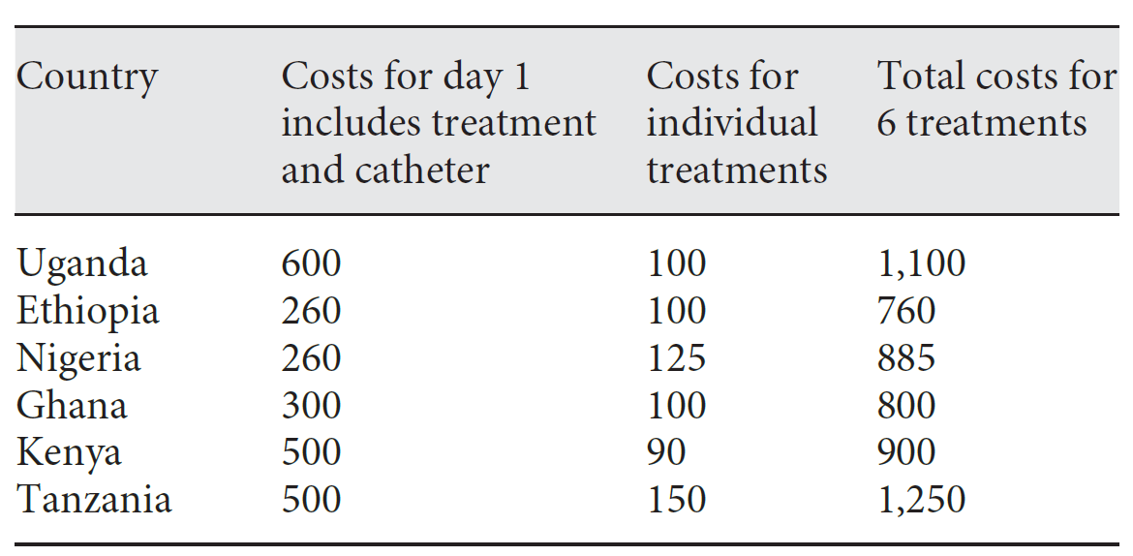
PD in Sub-Saharan Africa
Approximate costs (in USD) of dialysis in the private sector
Callegari J et al. Blood Purif 2013.

Slide 50
PD vs. HD in the management of paediatric acute kidney injury in Kano, Nigeria: a cost analysis
All children <15 years, who had either PD or HD for AKI.
Aminu Kano Teaching Hospital over a 1-year period.
The average cost of each dialysis modality was estimated.
To determine the cost of the dialytic management of paediatric AKI in a low-income country.
P. N. Obiagwu & A. Abdu. Tropical Medicine and International Health 2015.

Slide 51
PD vs. HD in the management of paediatric acute kidney injury in Kano, Nigeria: a cost analysis
20 children (dialysis for AKI) :
  12 (60%) HD and 8 (40%) PD.
  11 boys and 9 girls.
Age : 7.70 ± 4.49 years (1 week to 14 years).
  PD : 3.51 ± 3.44 years
  HD: 10.50 ± 2.43 years.
Over the 5-day period:
  HD: 2.58 ± 0.79 sessions
  PD : 37.5 ± 14.03 exchanges.
P. N. Obiagwu & A. Abdu. Tropical Medicine and International Health 2015.

Slide 52
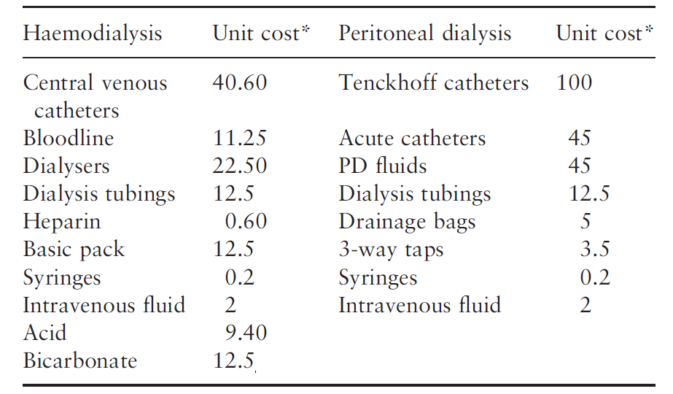
PD vs. HD in the management of paediatric acute kidney injury in Kano, Nigeria: a cost analysis
Consumables used in both modalities of dialysis
*All costs are in 2013 US dollars.
P. N. Obiagwu & A. Abdu. Tropical Medicine and International Health 2015.

Slide 53
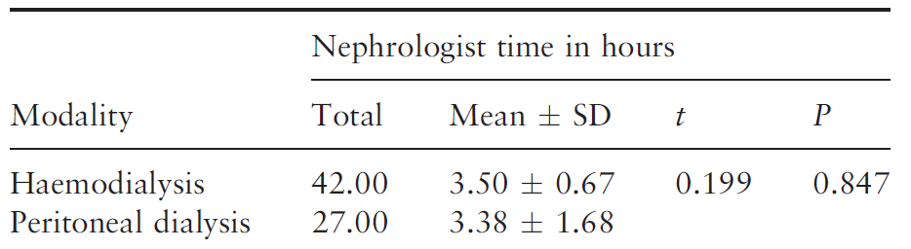
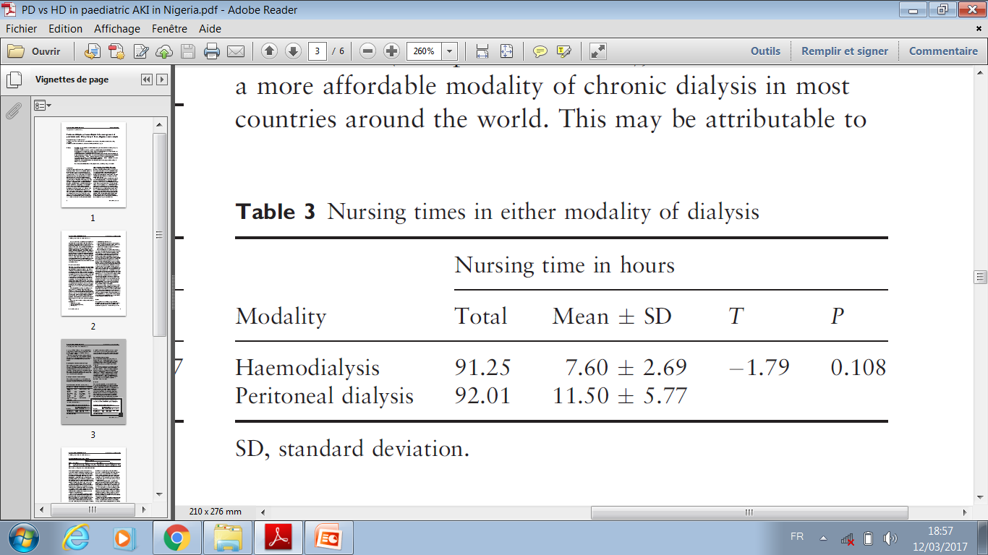
PD vs. HD in the management of paediatric acute kidney injury in Kano, Nigeria: a cost analysis
P. N. Obiagwu & A. Abdu. Tropical Medicine and International Health 2015.

Slide 54
PD vs. HD in the management of paediatric acute kidney injury in Kano, Nigeria: a cost analysis
 | HD | PD
Nephrologist | 585.37 (48.78 ± 9.40, 60.9) | 376.31 (47.04 ± 23.48, 39.1)
Nursing | 792.73 (66.06 ± 23.4, 49.8) | 799.12 (99.89 ± 50.15, 50.2)
Consumables | 2981.88 (248.49 ± 64.88, 69.4) | 1317.84 (164.73 ± 60.09, 30.6)
Total | 4359.98 (363.33 ± 96.55) | 2493.27 (311.66 ± 102.37)
P. N. Obiagwu & A. Abdu. Tropical Medicine and International Health 2015.

Slide 55
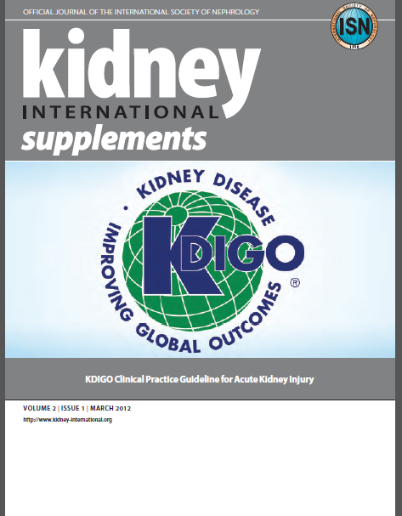
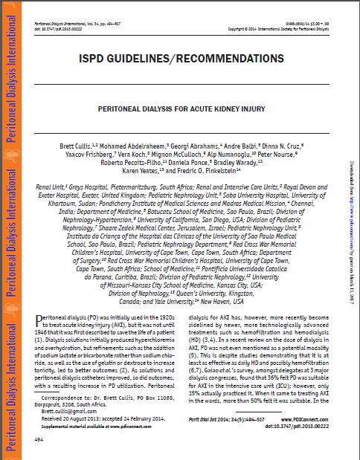
Pour plus d’informations
www.nephro-maroc.org

